Slide 1
SMA &
HULL TRADING
Week 2

Slide 2
Today’s Outline
Data Distribution
2. S-Volume Analysis
3. S-Score Metrics
4. Stationarity

Slide 3
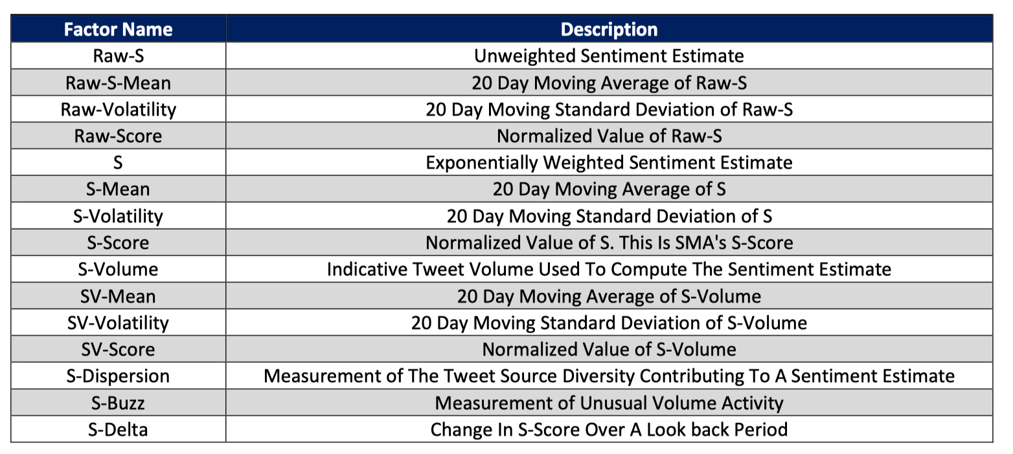
Data Factors

Slide 4
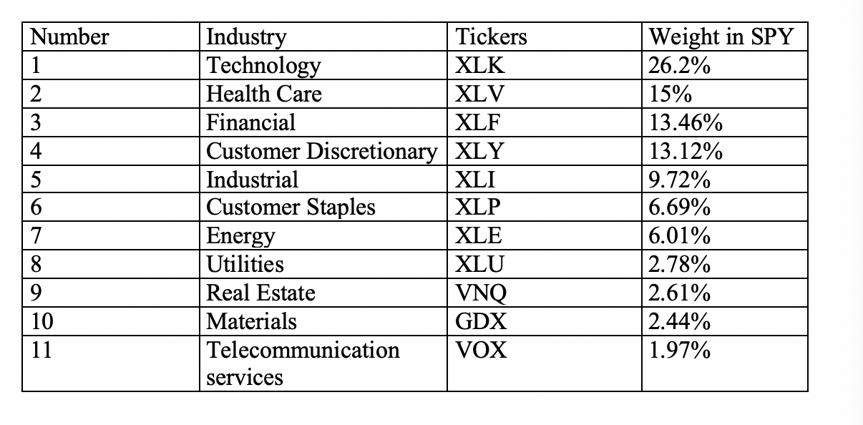
Data Selection

Slide 5
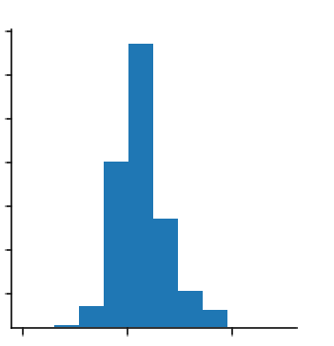
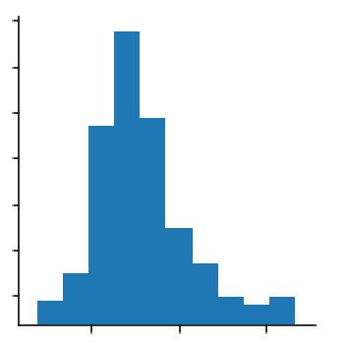
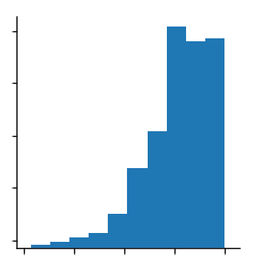
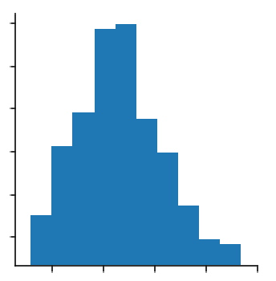
Data Distribution
Basically 4 types of distributions
Raw-S-Mean is right-skewed: there is some data that is relatively too high. May consider a skewed distribution.
S-dispersion is heavily left-skewed
S-volatility is closer to a normal distribution, however there are some outliers which we will discuss on the next slide
Raw-S has fat tails and many extreme values.
Raw-S
Raw-S-Mean
S-dispersion
S-volatility

Slide 6
Data Distribution
Raw-S, as we saw earlier, has fat tails and a lot of extreme values.
Raw-S must have high kurtosis, not normally distributed.
As a result, may consider it log-normal or Leptokurtic
Raw-S

Slide 7
2. S-Volume Analysis
Average S-Volume 2015 -2017
Top 25 Tickers (not shown): XLE, SLV, UWTI, EEM, USD, FXI, UUP, UNG, DUST

Slide 8
2. S-Volume Analysis

Slide 9
2. S-Volume Analysis

Slide 10
2. S-Volume Analysis

Slide 11
2. S-Volume Analysis

Slide 12
2. S-Volume Analysis

Slide 13
2. S-Volume Analysis

Slide 14
2. S-Volume Analysis

Slide 15
2. S-Volume Analysis

Slide 16
2. S-Volume Analysis

Slide 17
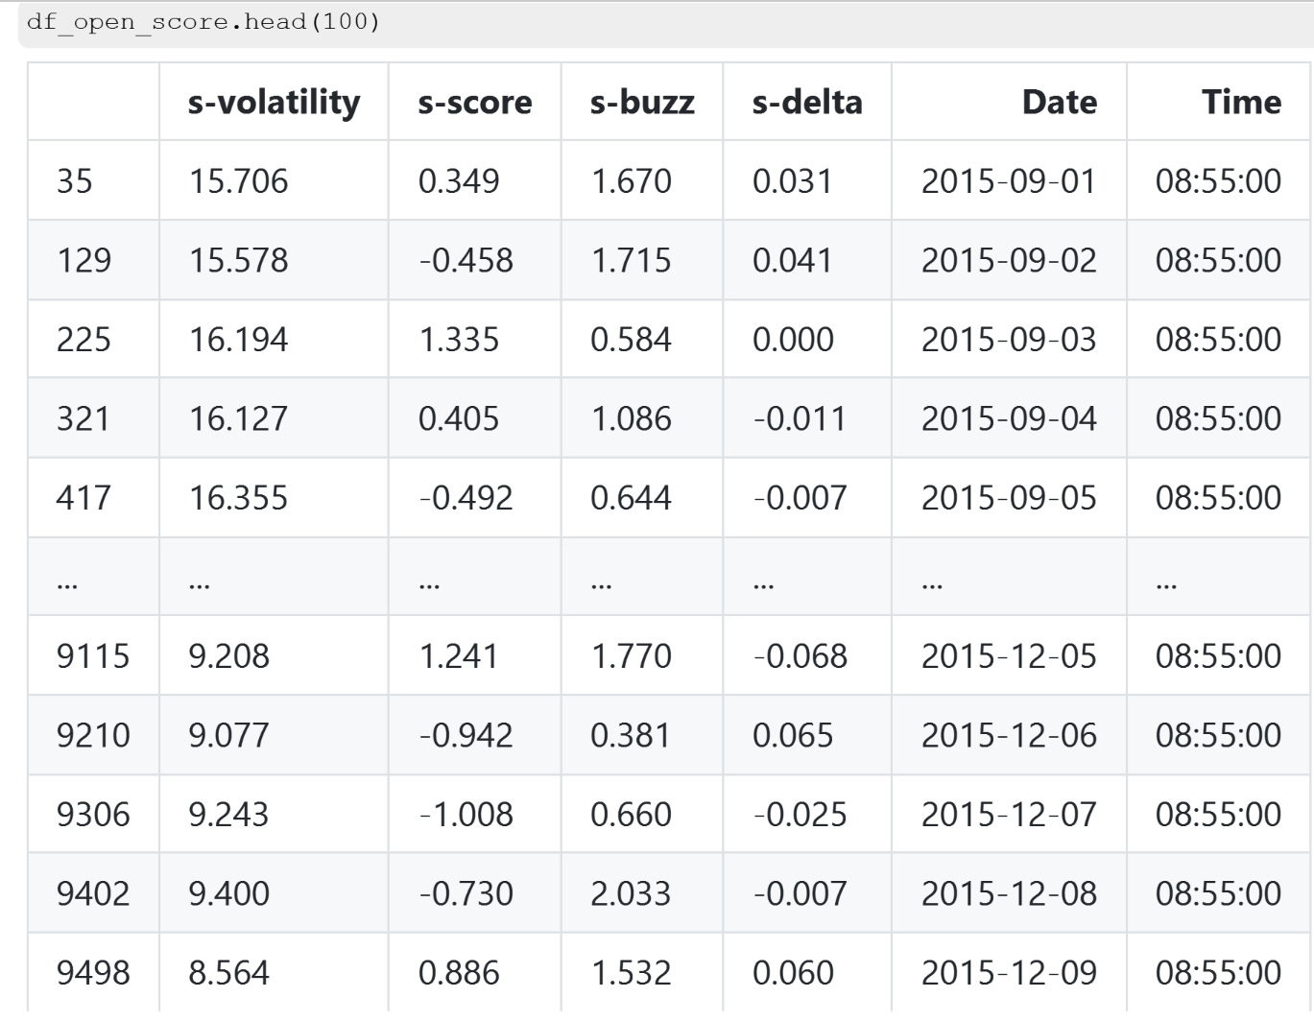
3. S-Score Metrics
S-Score is the normalized value of S-Volume
S-Volatility: 20-day moving average of “S” (exponentially-weighted sentiment estimate)
S-Buzz is the measurement of unusual volume activity

Slide 18
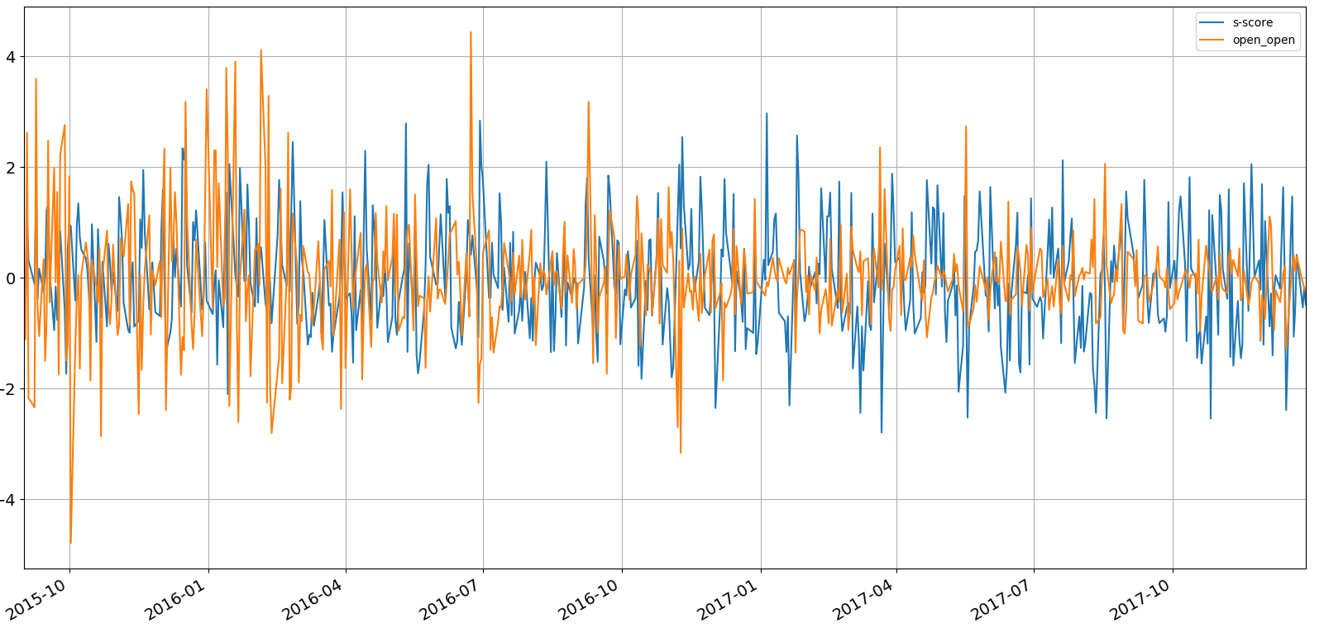
3. S-Score(Close) – Close to Close

Slide 19
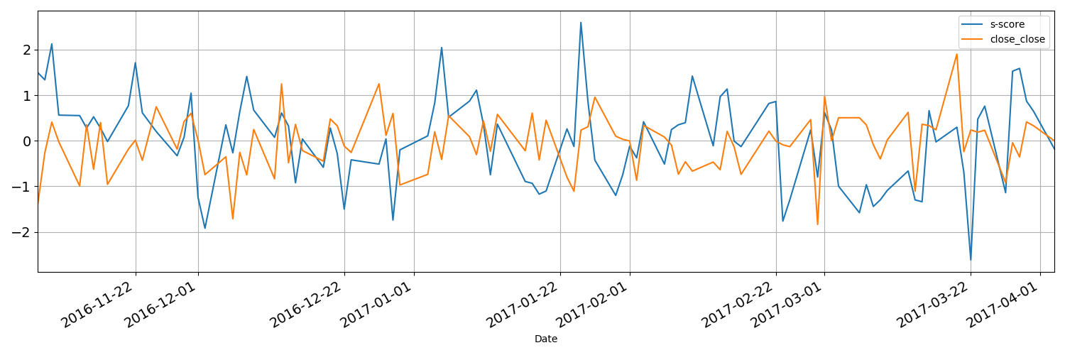
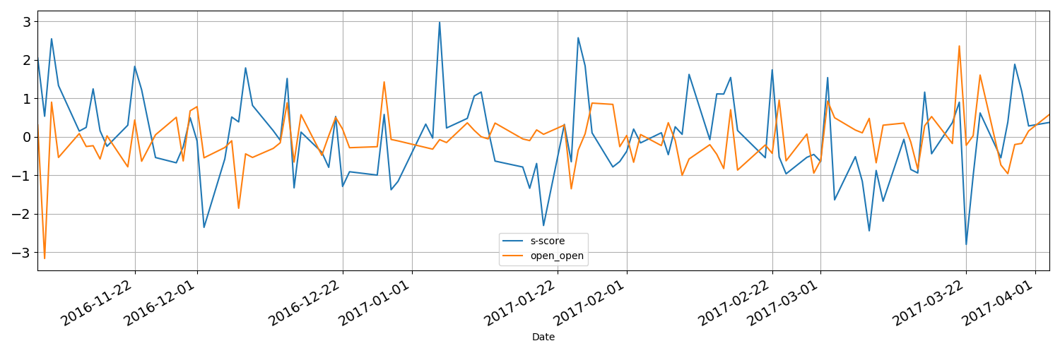
3. Lets zoom in…
Notice that some peaks in the S-Score is followed by a peak in the returns for both open-open and close-close

Slide 20
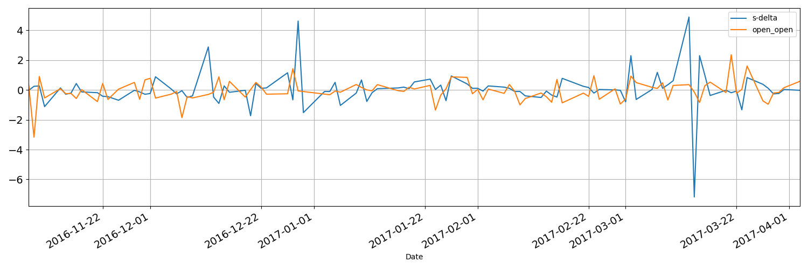
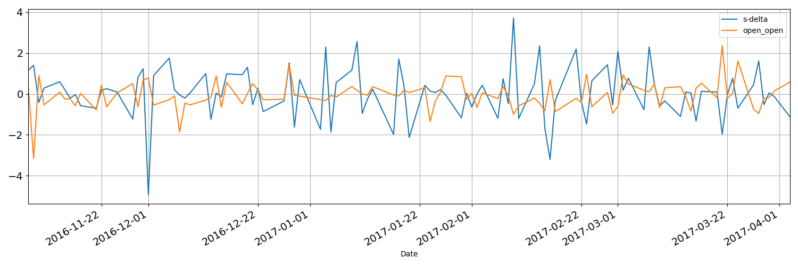
3. S-Delta: Noisy?
S-Delta measures the change in S-Score over a lookback period
Does not seem to give any glaring indicators or helpful information

Slide 21
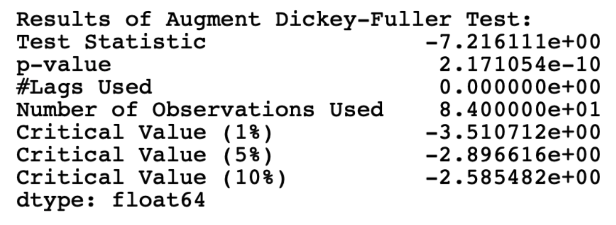
4. Stationarity check
Use ADF test Method.
The T-stats should be smaller than 0.05 at 95% confidence level.
in this case it is so small that we can say it's definitely stationary.
p-value should be as small as possible as well, which is true.

Slide 22
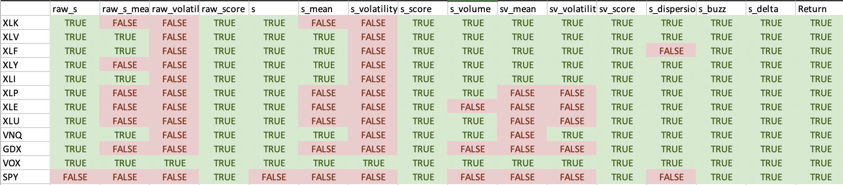
4.Stationarity check
Use ADF test on every data-set and every factor. This is the result.

Slide 23
Conclusion
Proved most of data is stationary so we can potentially use time-series models
Depending on importance of S-volume, we might want to reconsider the tickers we initially picked.
Top-25 in Avg. S-volume make up 32% of the Total Avg. S-volume.
Vectors Gold Miners ETF (GDX) and SPDR Financial Select (XLF) are the only 2 tickers in current analysis
Correlation analysis (ETF heatmap) shows that we can’t use a model that relies on correlation (ETFs do not give good inference)
S-Score shows some promise for prediction and forecasting. Theory needs more rigorous testing.

